Slide 1
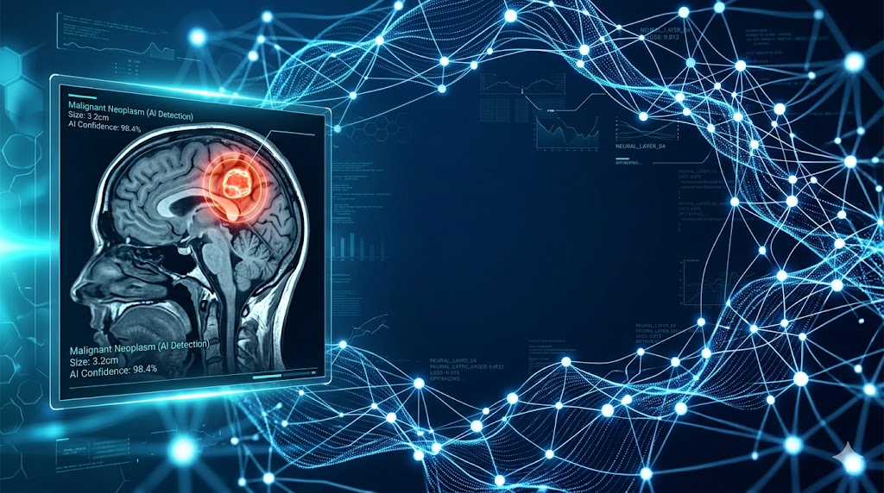

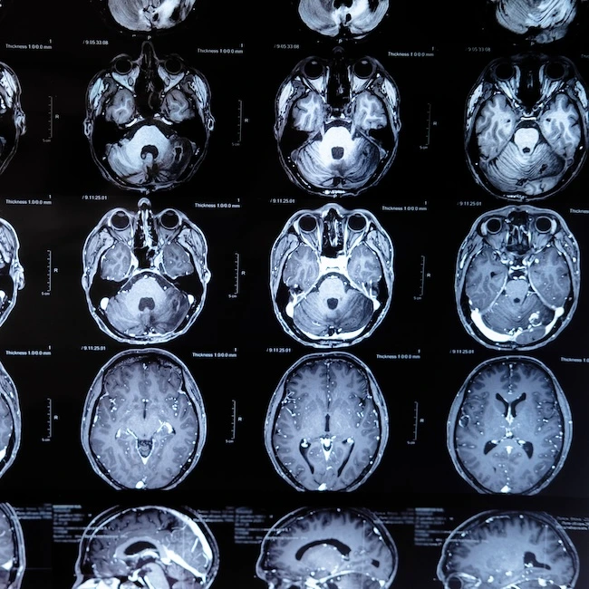

Brain Tumor Detection, Classification, and Segmentation using MRI Scans
Aryan Sengar (23CSU055) | Deep Learning Project
Mentor: Dr. Ashima Rani | 20-04-2026

Slide 2


Introduction
Transforming Healthcare with AI
Brain tumor detection represents a critical intersection of medical science and artificial intelligence. Early diagnosis dramatically improves patient outcomes, yet manual analysis remains time-consuming and prone to human error.
This project leverages deep learning to automate detection, classification, and precise segmentation of brain tumors from MRI scans, enabling faster, more accurate diagnosis and treatment planning.

Slide 3
Problem Statement
The Challenge
The Impact
Manual diagnosis is time-intensive and subjective
Subtle tumor characteristics easily overlooked
High inter-observer variability among radiologists
Limited availability of expert neurologists
Delayed treatment initiation
Potential misdiagnosis or missed cases
Inconsistent treatment protocols
Overwhelmed healthcare systems
Automation Solution: Deep learning models can process thousands of scans rapidly, identify patterns invisible to human eyes, and provide consistent, objective analysis—revolutionizing diagnostic workflows.

Slide 4
Project Objectives
Precision Segmentation
Tumor Type Classification
Generate pixel-level masks delineating exact tumor boundaries and regions for surgical planning
Binary Classification
Distinguish between meningioma, glioma, and pituitary tumor types for precise diagnosis
Detect presence of tumor vs healthy brain tissue with high sensitivity and specificity

Slide 5

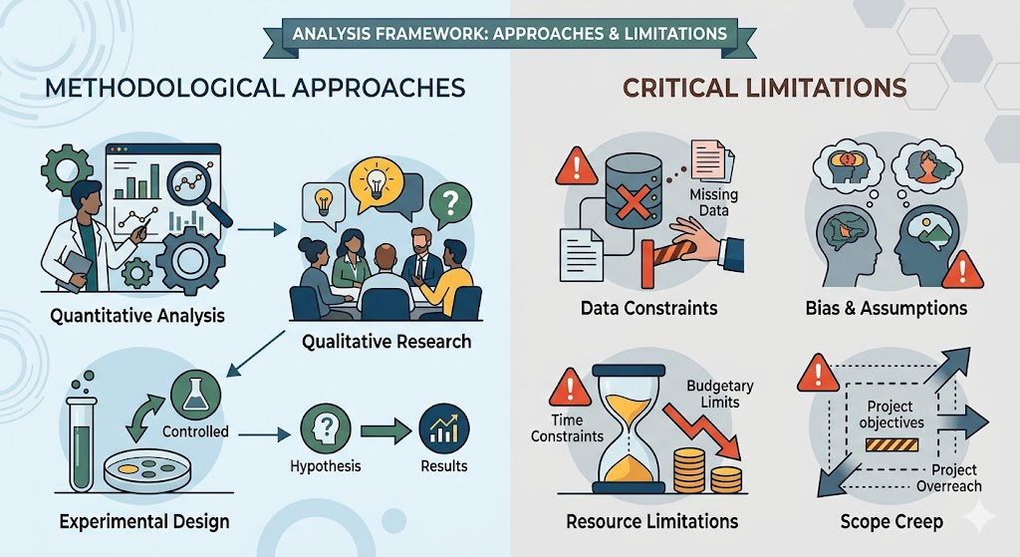
Literature Review
Existing Approaches
Current Limitations
Single-task models lacking integration
Moderate accuracy on diverse datasets
Limited segmentation precision
Computational inefficiency
Traditional CNN architectures (VGG, ResNet, Inception) demonstrated promise in medical imaging. Transfer learning reduced training time significantly. U-Net pioneered encoder-decoder structures for segmentation.
This project addresses these gaps through a multi-stage pipeline combining optimized architectures, domain-specific preprocessing, and ensemble techniques for superior performance.

Slide 6

Proposed Methodology
Detection
Type ID
Segmentation

Slide 7



Dataset Details
Dataset 1: Binary Classification
Dataset 2: Type Classification
Dataset 3: BraTS
Source: BraTS challenge
Format: 3D multi-modal
Classes: Fine-grained regions
Purpose: Segmentation
Source: MRI + CT scans
Format: 2D slices (PNG)
Classes: Tumor / Healthy
Purpose: Initial detection
Source: MRI scans
Format: 2D slices (PNG)
Classes: Meningioma, Glioma, Pituitary
Purpose: Subtype identification

Slide 8
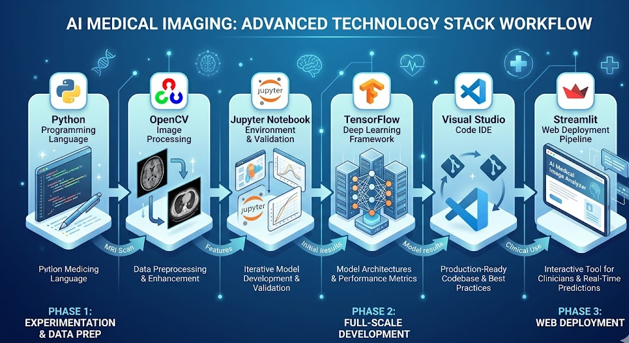
Tools and Technologies
Core Stack
Python: Backend logic and model implementation
TensorFlow/Keras: Deep learning framework
OpenCV: Image preprocessing and augmentation
Jupyter Notebook: Interactive experimentation and model training
Visual Studio Code: Development environment for coding and project integration
Streamlit: Web interface for model deployment

Slide 9
Timeline & Work Plan
Phase 1: Data Collection
1
Curate datasets, implement preprocessing pipelines, validate data quality
2
Phase 2: Model Development
Build and train three-stage pipeline, optimize hyperparameters
Phase 3: Integration
3
Connect models into unified workflow, implement validation framework
4
Phase 4: Testing
Evaluate performance metrics, conduct error analysis
Phase 5: Deployment
5
Deploy web interface, document methodology and results

Slide 10
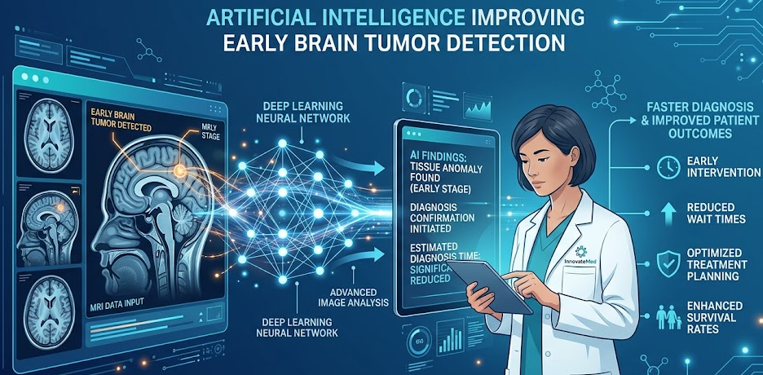
Expected Outcomes & Impact
95%+
3-Stage
24/7
Target Accuracy
Integrated Pipeline
Availability
High precision across all three stages
Complete diagnostic workflow
Continuous automated analysis
Transformative Potential
This multi-stage deep learning system promises to revolutionize neuro-oncology by enabling rapid, accurate tumor diagnosis. By automating detection, classification, and segmentation, healthcare providers can focus on treatment planning while AI handles initial screening—expanding access to quality care globally.

